Slide 1
Data Security through Steganography & Cryptography
Presented by:
Deep sharan shrestha

Slide 2
SECURITY THROUGH CRYPTOGRAPHY AND STEGANOGRAPHY
encrypt the actual data that is present in the data file,
hide the confidential information in other form of media using steganography,
extract the confidential information form the encrypted text which is embedded in stegano-media
Notes:
3 major part

Slide 3
Objective and Importance
allows one to exchange sensitive information without attracting unnecessary attention.
store confidential data by hiding it within seemingly innocuous files.
Enables one to share stego-media publicly so than a thirdparty with a key can easily access the hidden text.

Slide 4
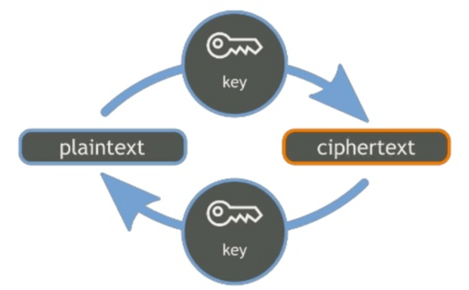
CRYPTOGRAPHY
Practice/studies of techniques for secure communication in presence of an adversary,

Slide 5
Advanced Encryption Standard
uses symmetric encryption algorithm.
operates on blocks of data and uses a secret key to perform encryption and decryption.
The algorithm itself does not encrypt words directly but operates on binary data,

Slide 6
How Does AES Work?
Key Expansion: AES takes a secret key as input and expands it into a set of round keys, which are used in the encryption and decryption process.
Initial Round: AES starts with an initial round of operations on the input data. The data is divided into blocks, typically 128 bits (16 bytes) each.
Rounds: AES consists of a series of rounds, which vary based on the key size. For AES-128, there are 10 rounds; for AES-192, there are 12 rounds; and for AES-256, there are 14 rounds.
SubBytes: In each round, the input data goes through a byte substitution step called SubBytes. Each byte of the input is replaced with a corresponding byte from a substitution box (S-box), which is a fixed table.
ShiftRows: After the SubBytes step, AES performs a transposition operation called ShiftRows. Each row of the state matrix is shifted cyclically to the left.
MixColumns: Next, AES applies a matrix multiplication operation called MixColumns. Each column of the state matrix is multiplied by a fixed polynomial, modulo another fixed polynomial, resulting in a diffusion of the data.
AddRoundKey: In each round, the current round key is combined with the state matrix using the bitwise XOR operation. This step adds the round key derived from the original secret key.

Slide 7
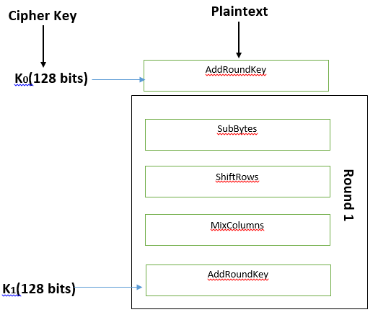
Final Round: The final round excludes the MixColumns step.
Output: After the last round, the resulting state matrix is the encrypted data

Slide 8
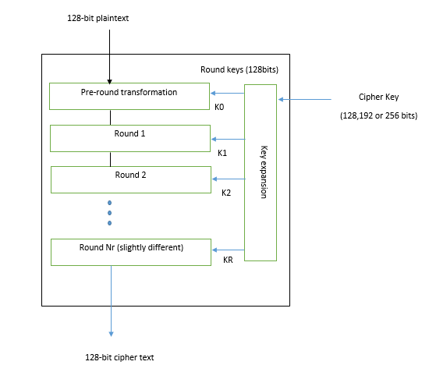

Slide 9
AES Decryption
The Process of decryption of an AES cipher text is similar to the encryption process in the reverse order. Each round consists of the four processes conducted in the reverse order.
Add round key
Mix columns
Shift rows
Byte substitution

Slide 10
DATA HIDING
software development technique specifically used in object-oriented programming,
ensures exclusive data access to class members preventing unintended or intended changes,
ability to prevent certain aspects software component from being accessible to its clients,

Slide 11
STEGANOGRAPHY
The basic structure of Steganography is made up of three components.
Carrier - The carrier can be a painting, a digital image, audio file, even a TCP/IP packet among other things. It is the object that will ‘carry’ the hidden message.
Message - The message is being carried by the object (carrier).
Password - A key is used to decode/decipher/discover the hidden message

Slide 12
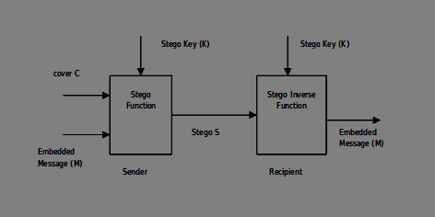

Slide 13
HOW DOES STEGANOGRAPHY WORK
Least Significant Bit
embeds the bits of the secret message data in order at the least significant bit of the pixel value
Bit Plane Complexity
cover image is divided into blocks and classified into information and noisy blocks,
the secret data is hidden into noisy blocks
Notes:
earliest stego-systems were those referred to as Least Significant Bit Substitution techniques

Slide 14
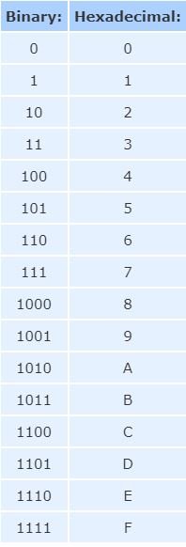
LSB ENCODING BASIC CONCEPT

Slide 15
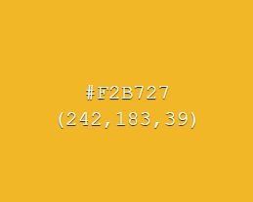
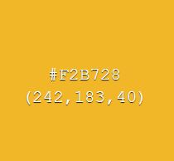
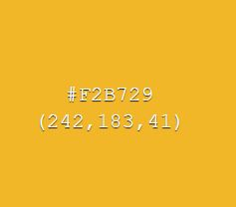
1-BIT DIFFERENCE IN A PIXEL

Slide 16


Image Steganography using LSB
Cover Image
Secret DATA
Stego-Image
ANY SECRET TEXT

Slide 17
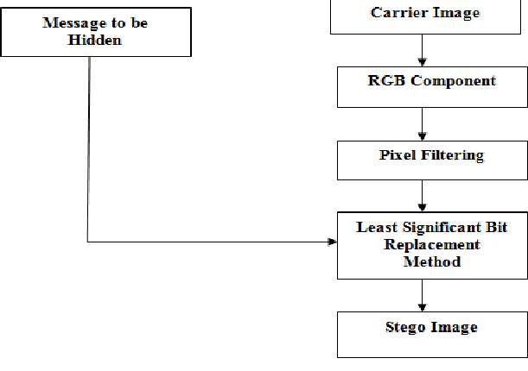
IMAGE STEGANOGRAPHY

Slide 18
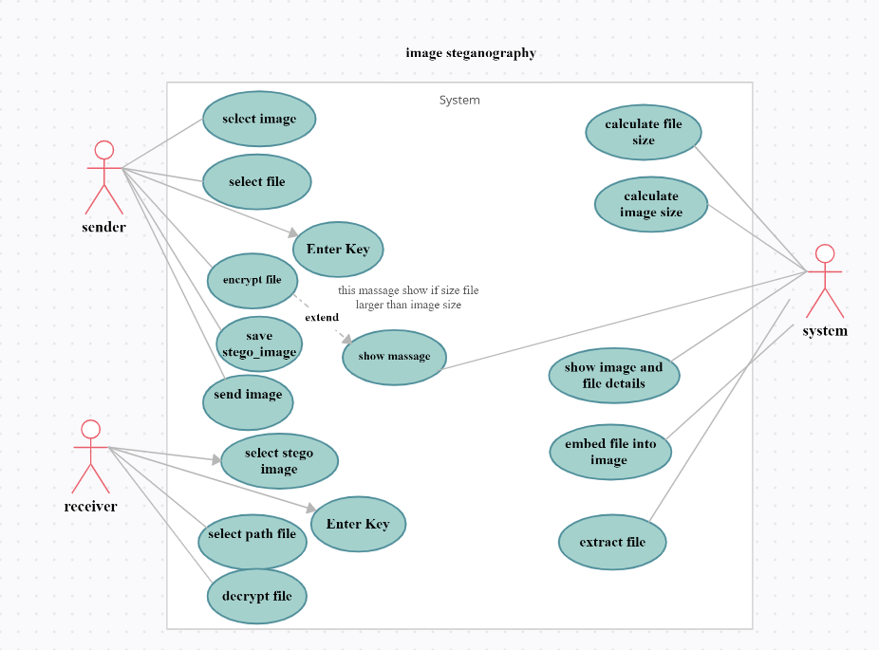

Slide 19
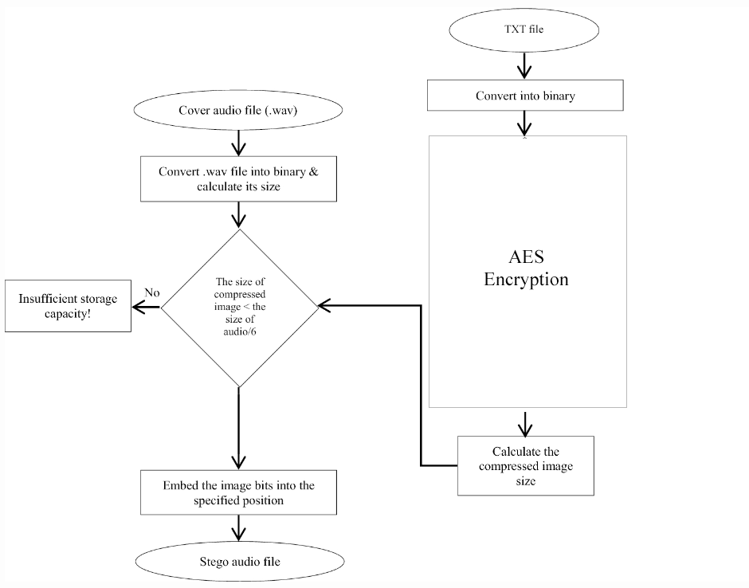
AUDIO STEGANOGRAPHY
Notes:
Tc: set character spacing
Tw: word spacing
Tz: horizontal spacing

Slide 20
LIMITATIONS
Only lossless image file format could be used like .png
this project only allows .wav audio format,
Audio decryption requires original file size in bytes.
the exchange of the keys/password and algorithm that is used, should be done through another secure channel

Slide 21
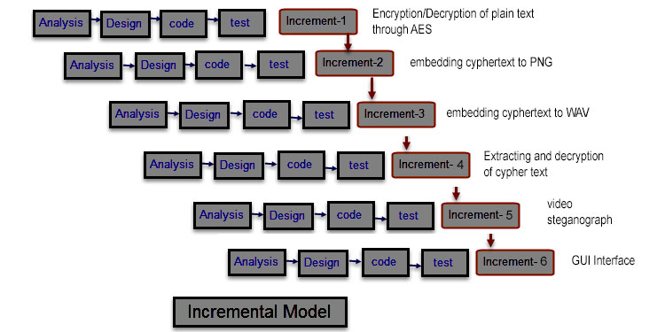
PROPOSED METHODOLOGY

Slide 22
Analysis Phase
Input Requirement: A carrier media, a text file that has a message and a passphrase to generate the key.
Output: The output we receive is the stegano-media.
Functional Requirement: Encrypt plain text, convert to binary, use LSB Encoding, get the data from stego-media, decrypt plain text.

Slide 23
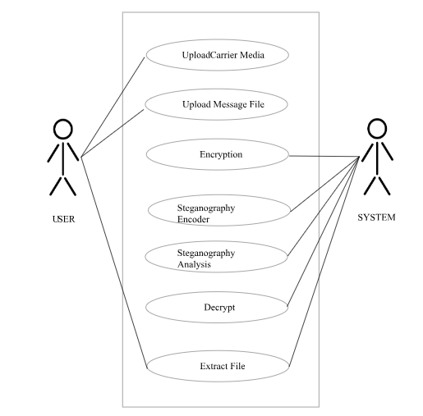
Design Phase (USE CASE)

Slide 24
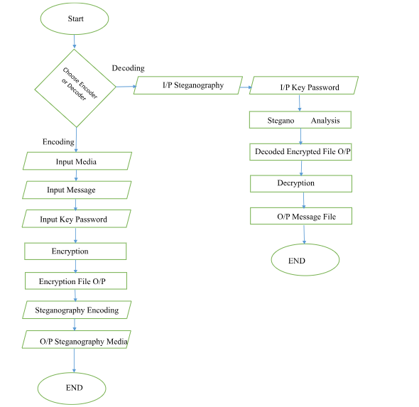
Flow Chart

Slide 25
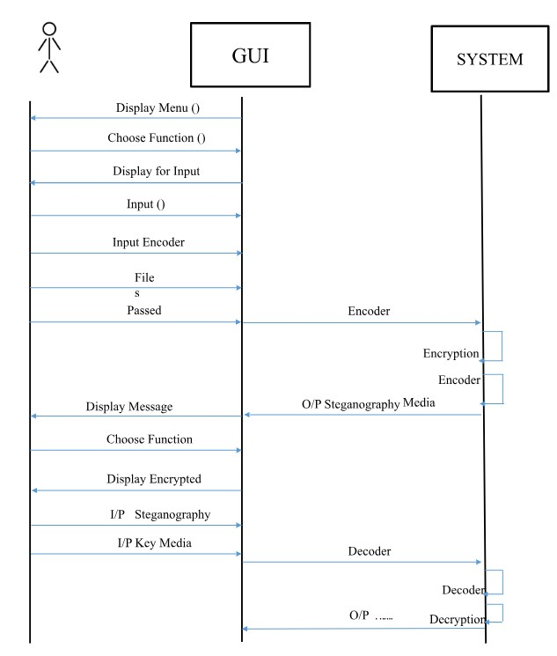
System Sequence Diagram

Slide 26
TOOLS AND TECHNOLOGY USED
Python
Tkinter (GUI for python)
AES-128 encryption for file.

Slide 27
Testing
Test No | Function | Test | Expected Result | Outcome
1. | Encryption | Generate the cipher text from the message file | A encrypted file containing the cipher text | Successful
2. | Decryption | Decrypt the encrypted file | A text file with readable message | Successful
3. | Encoding | Embed the message file in image | The message hidden in the image | Successful
4. | Decoding | Decode carrier image to get hidden file | Recovered text file | Successful
5. | Encoding | Embed the message file in audio file | The message file hidden in the audio | Successful
6. | Decoding | Decode carrier audio to get hidden file | Recovered text file | Successful

Slide 28
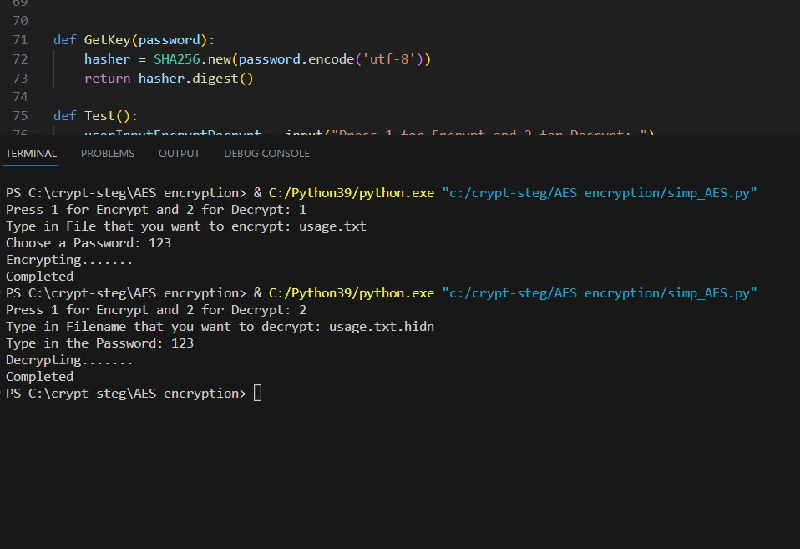
AES Encryption

Slide 29
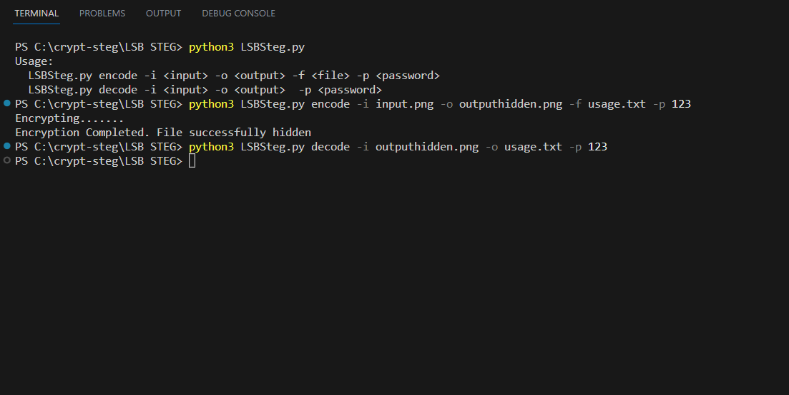
Image Steganograph

Slide 30
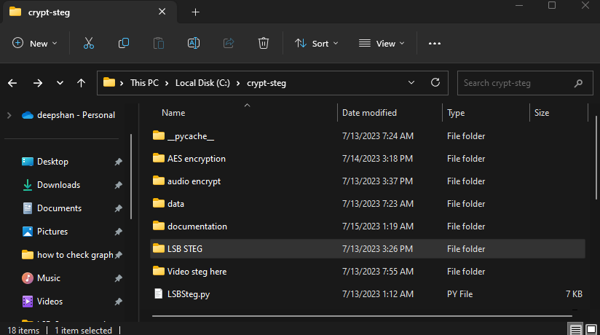
Image Comparison
Original
Stegano-Image

Slide 31
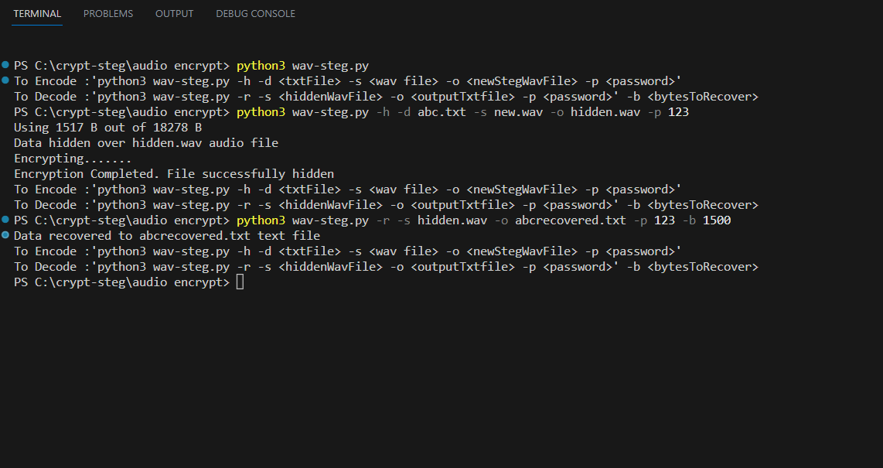
Audio Steganograph

Slide 32
CONCLUSION
At the completion of this project, it will deliver the following:
A fully function desktop application program that can encrypt and decrypt the files, and also hide those encrypted file to a carrier media(image, audio and video)
A detailed project report document

Slide 33
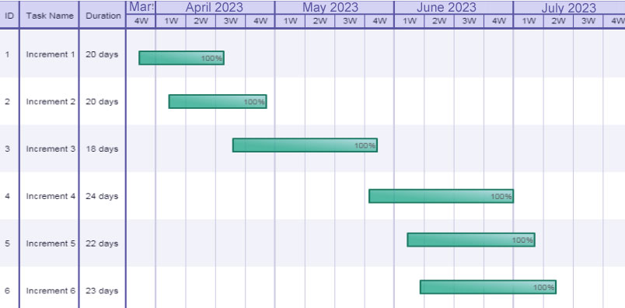
GHANTT CHART

Slide 34
THANKYOU

